Slide 1
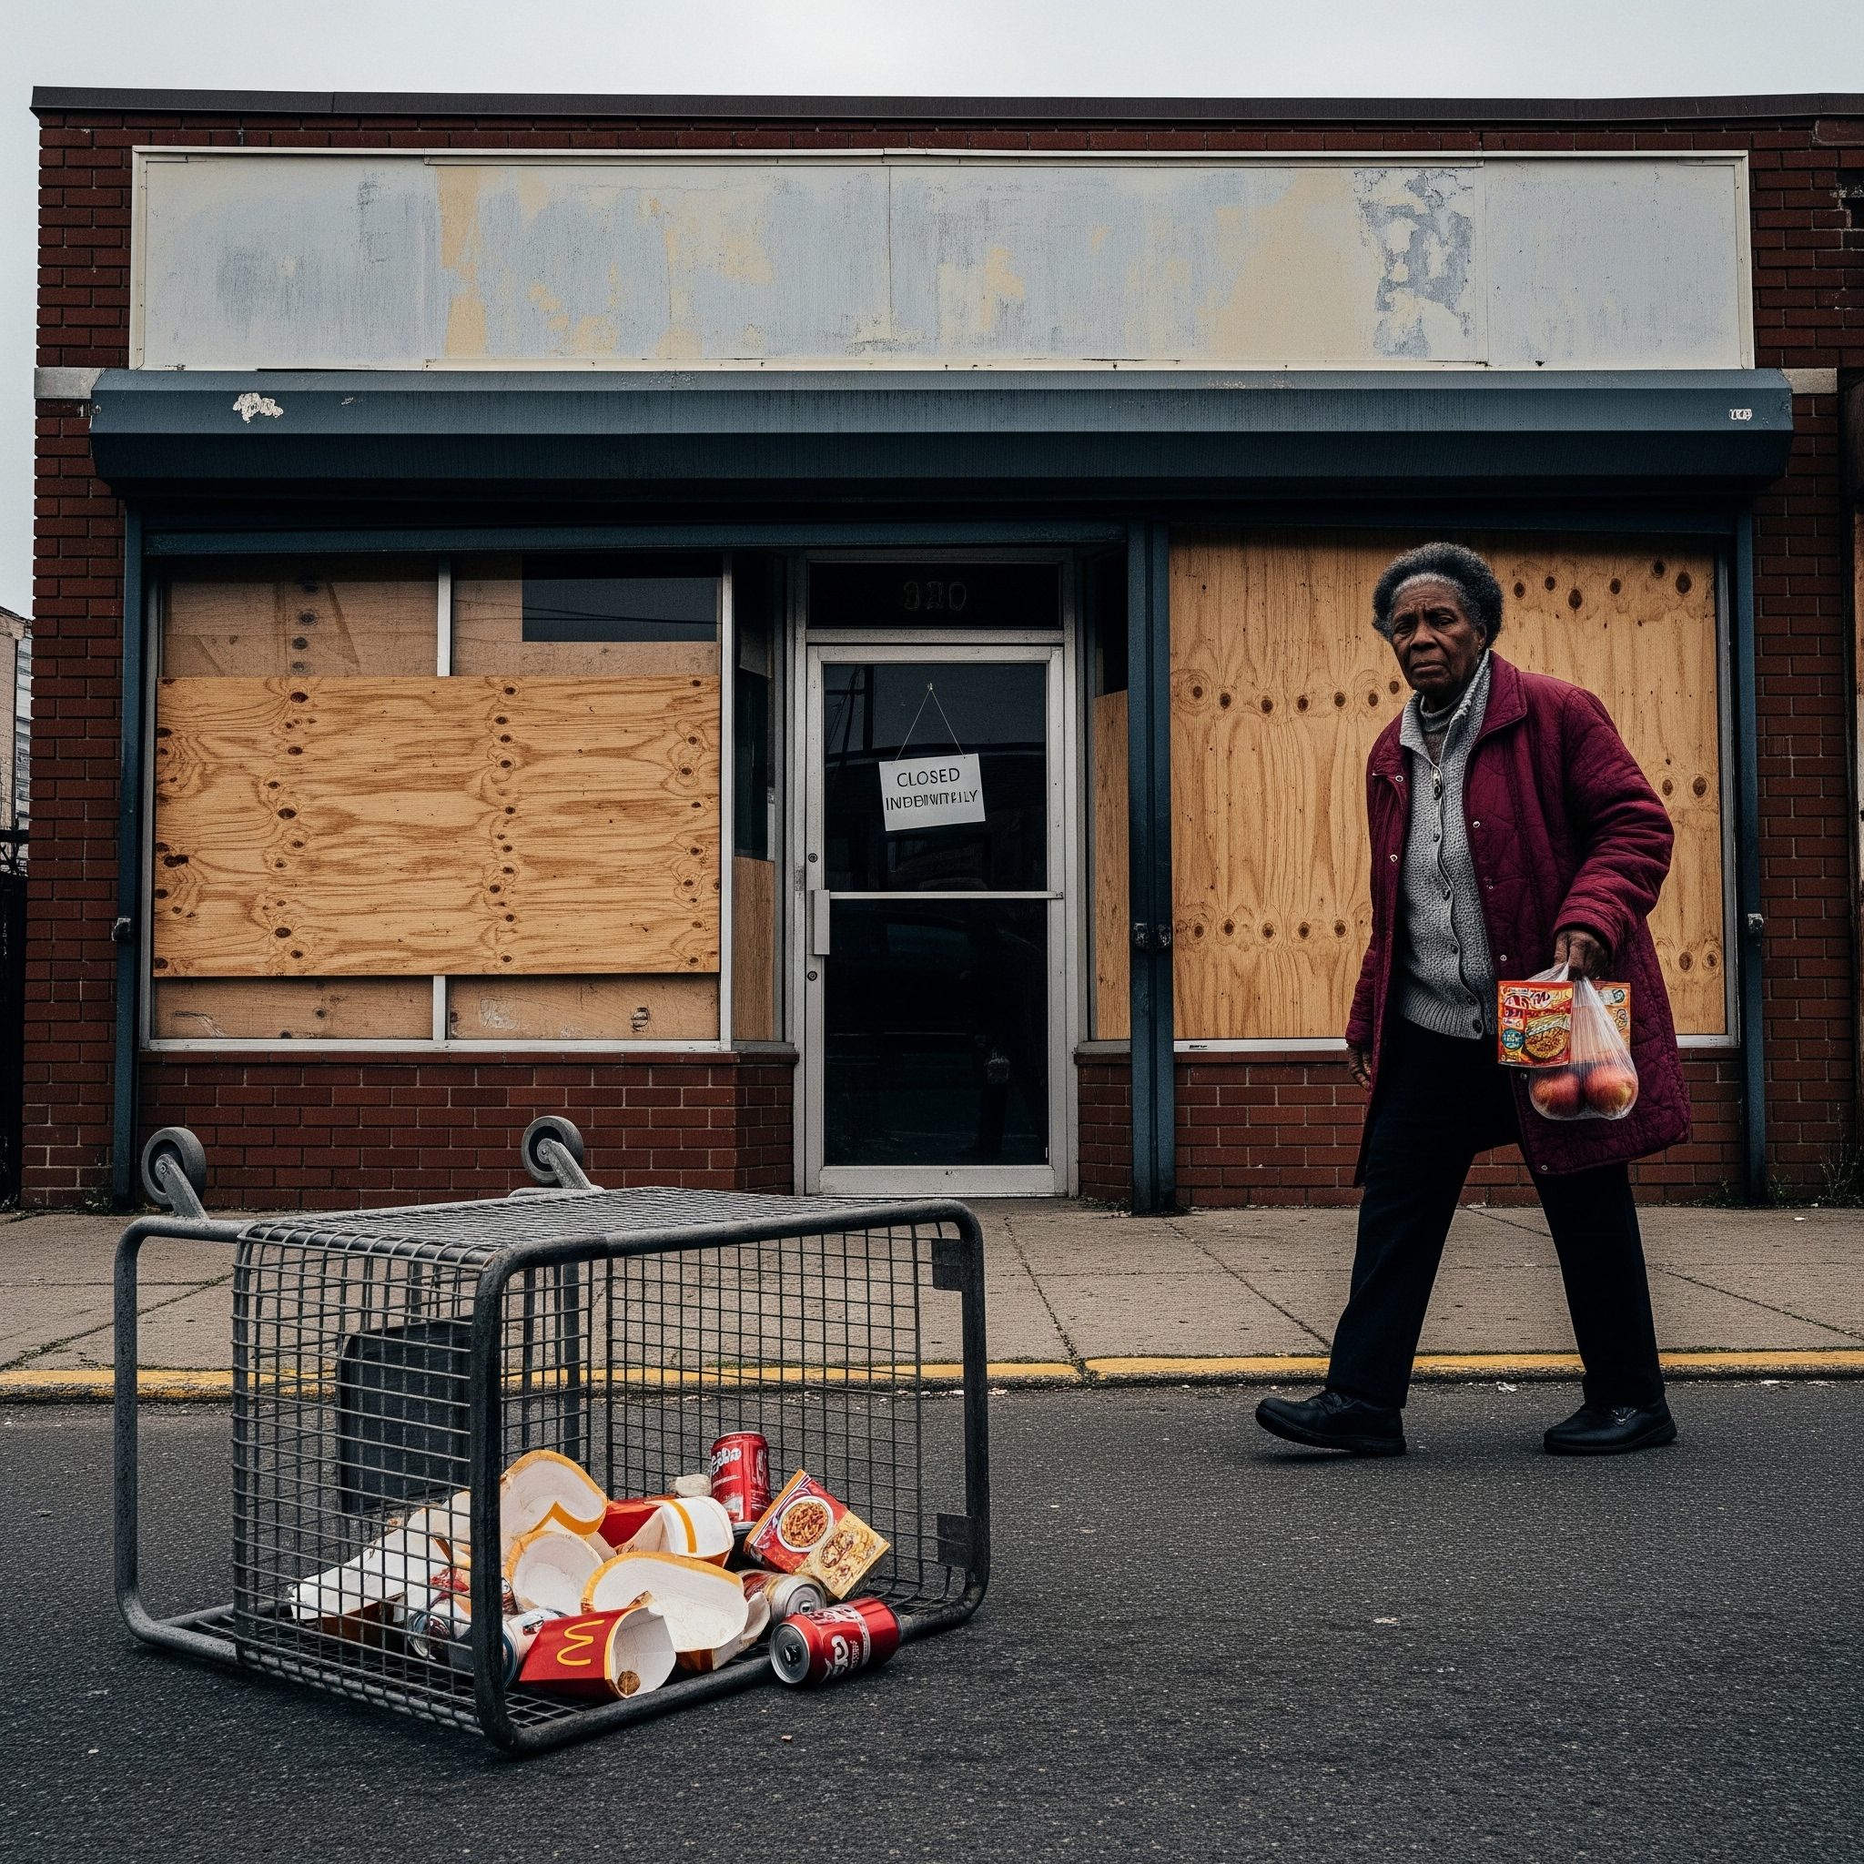
Business Report Presentation
Topic: Food Deserts in Black Communities
Focus Area: Washington, D.C. [Wards 7 & 8]
Course: ENGL 009
Presenter: Basanta Baral
Date: 11/13/2025

Slide 2
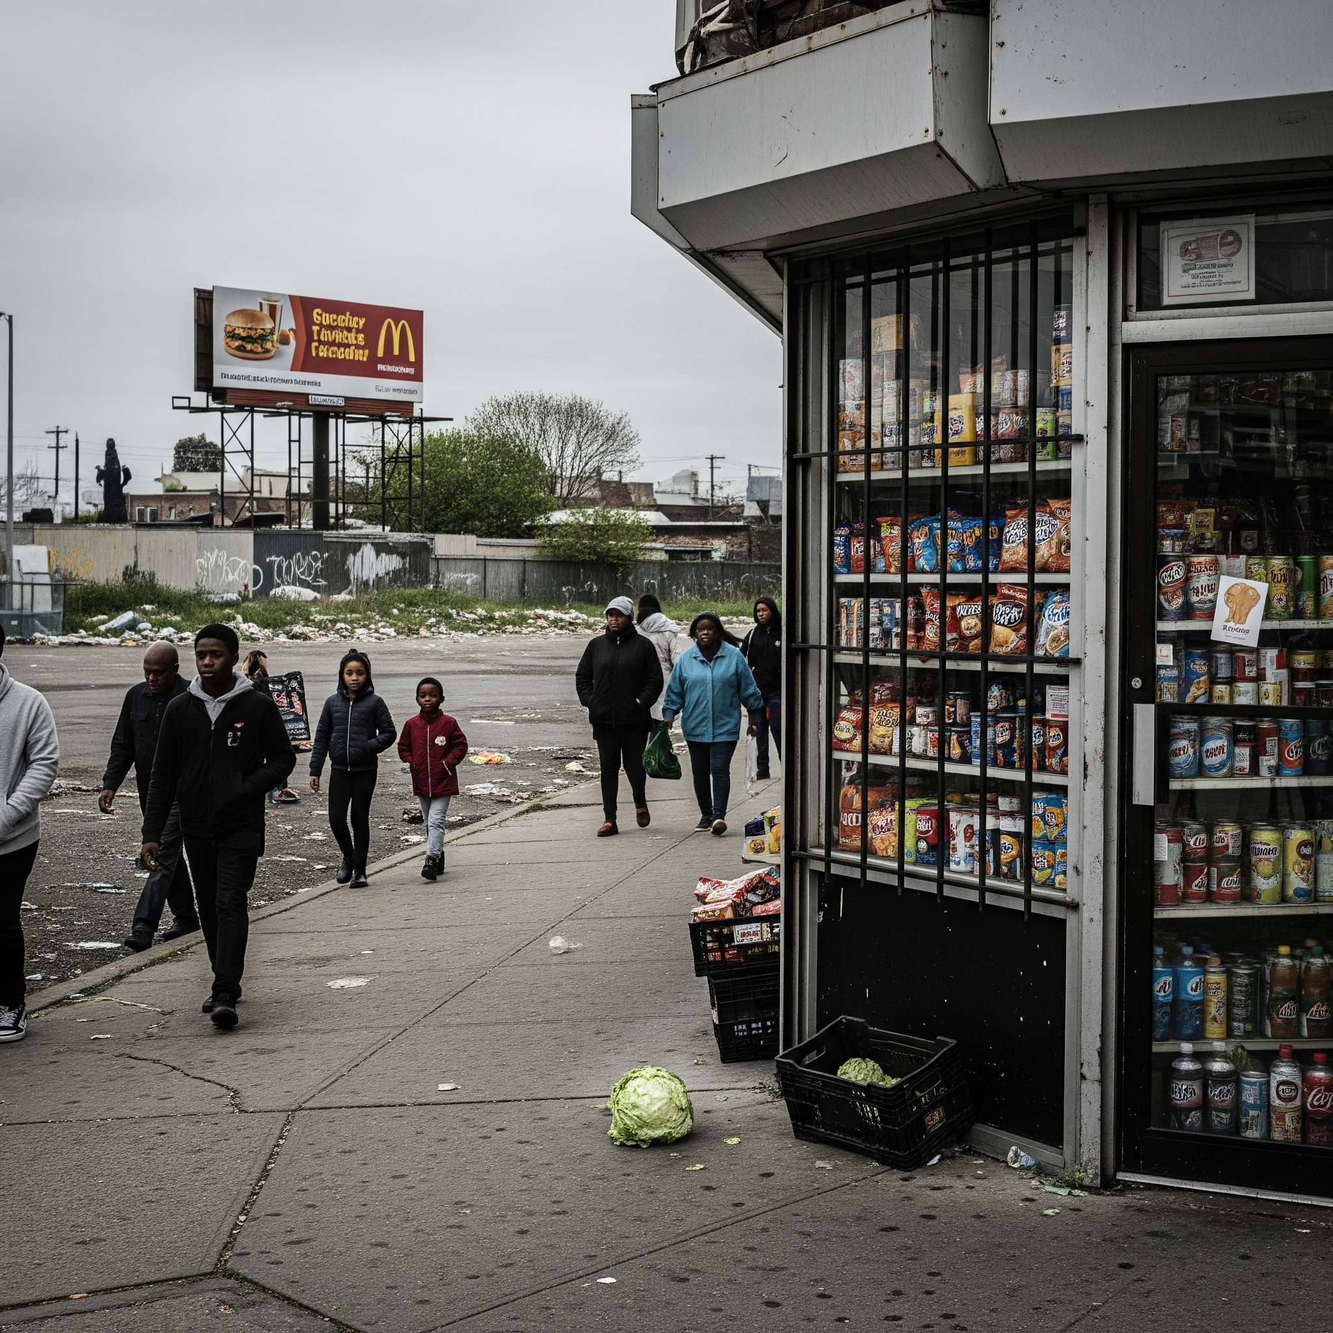
What Food dessert is?
Food deserts are areas where residents lack access to:
Affordable, healthy foods
Full-service grocery stores
Fresh fruits and vegetables
In Wards 7 & 8, residents have travel long distances for basic groceries, harming physical and economic well-being.

Slide 3
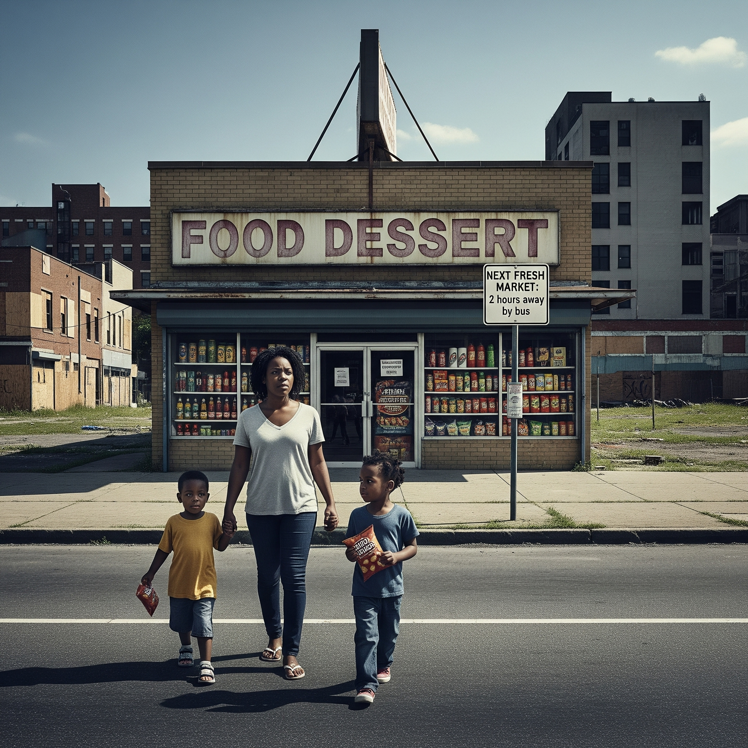
Problem
Wards 7 & 8 have very few full-service grocery stores.
Residents have to travel long distances for basic groceries.
Transportation barriers make accessing healthy food difficult.
Corner stores and fast-food restaurants dominate the area.
Leads to poor nutrition, higher food costs, and long-term health risks.

Slide 4
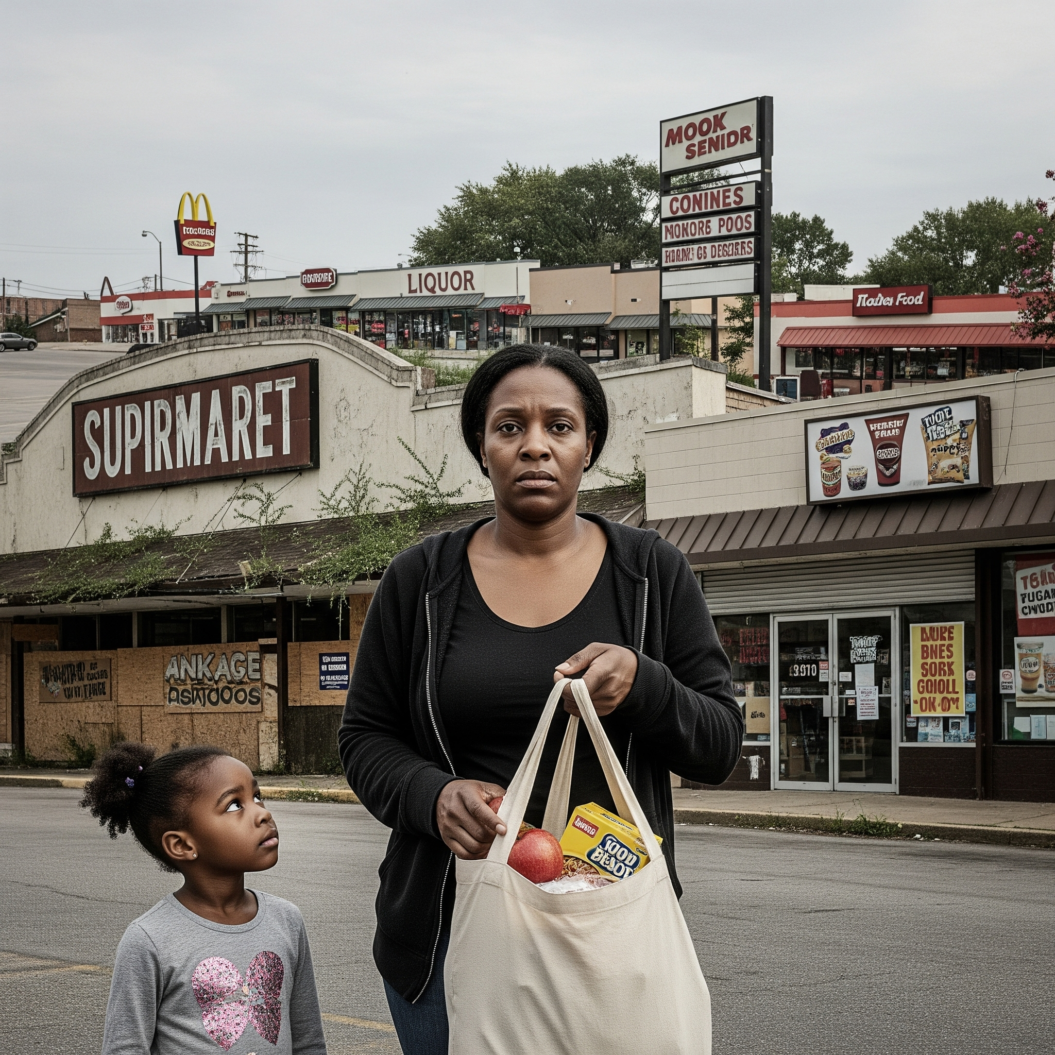
Why this matters?
Food deserts contribute to:
High rates of obesity, diabetes, and hypertension
Greater reliance on fast food and corner stores
Higher grocery costs and financial strain
Long-term health and economic inequities
This is a public health, economic, and social justice issue.

Slide 5
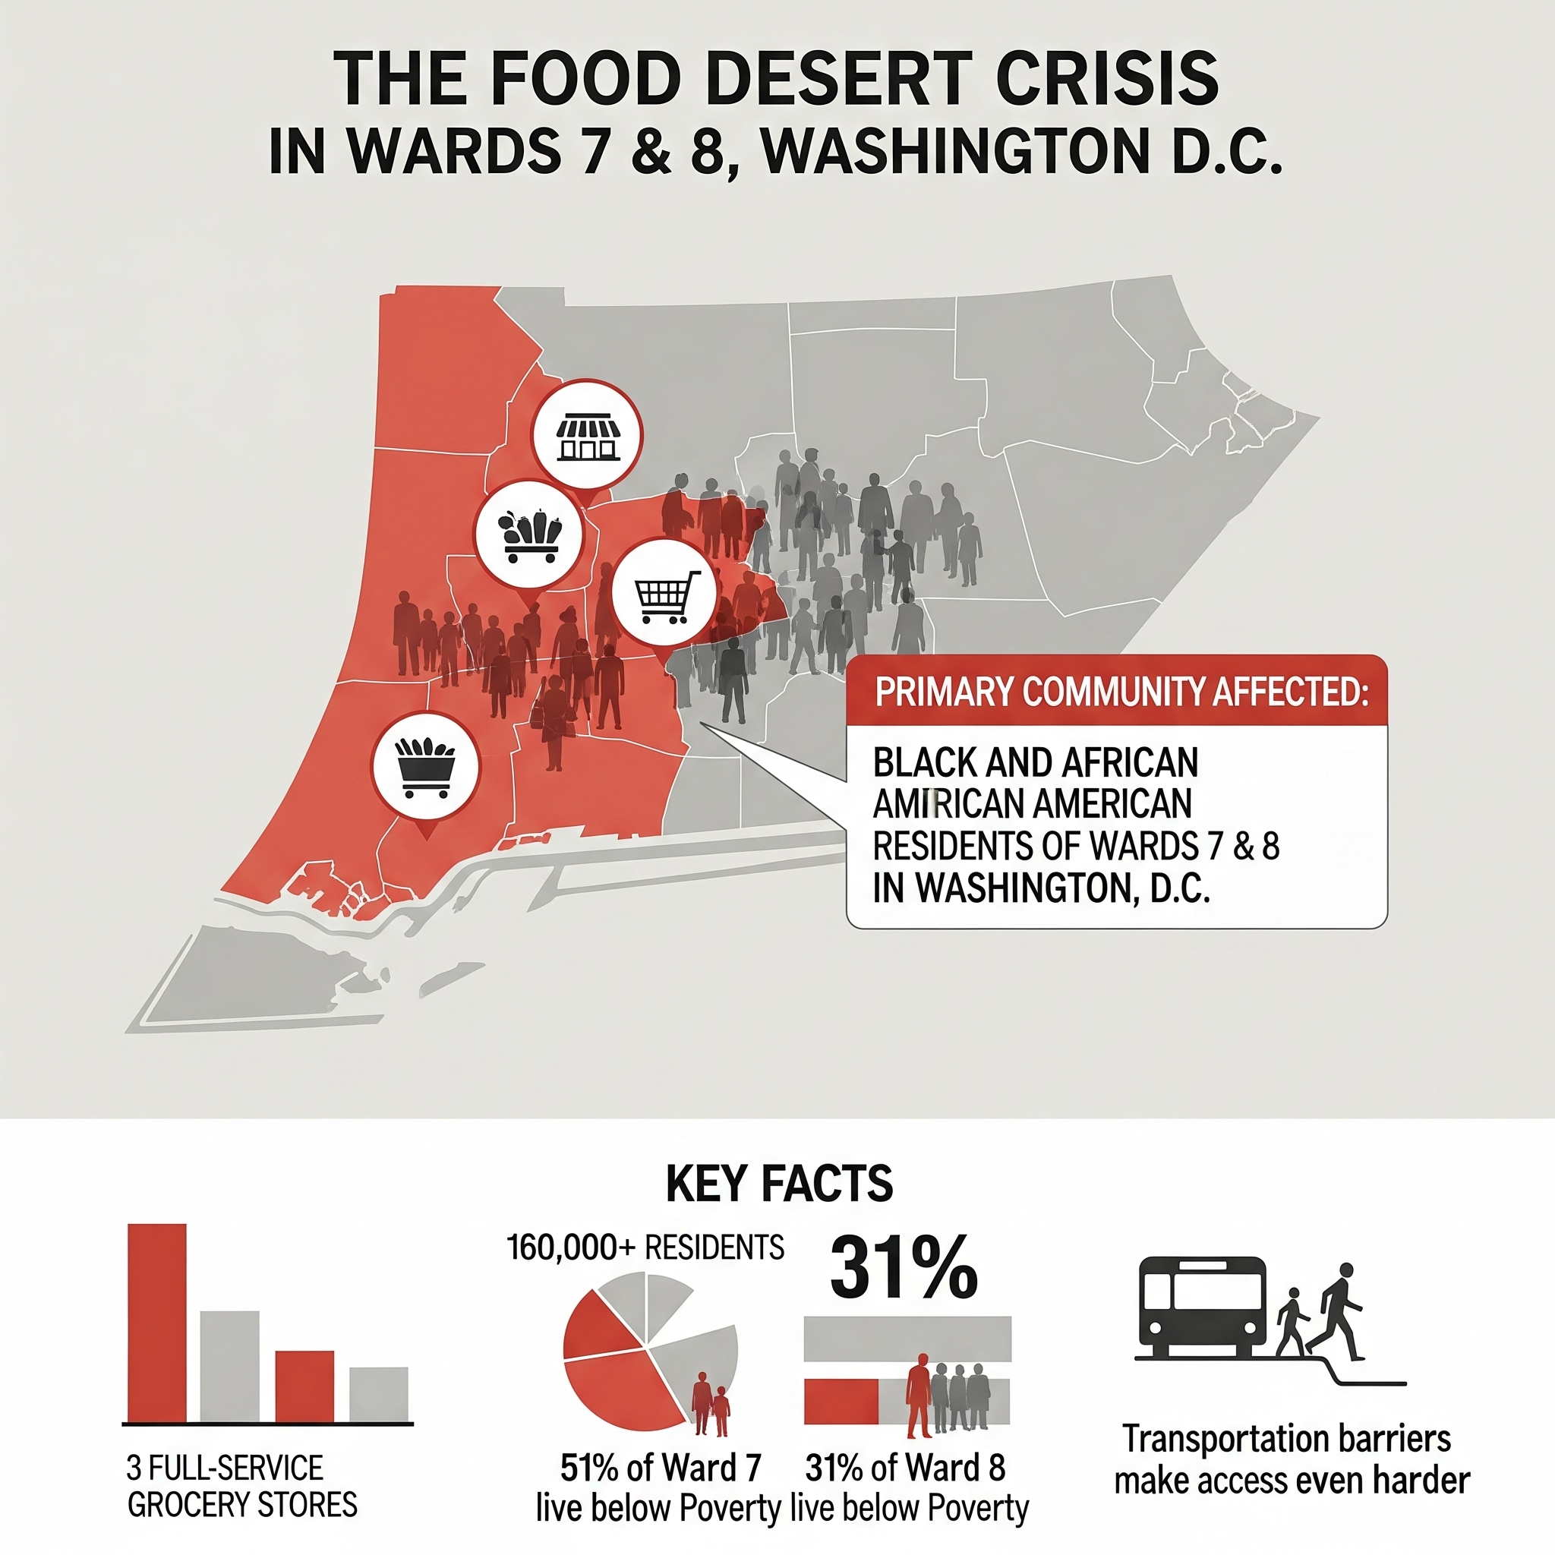
Who Is Mostly Affected?
Primary Community Affected:
Black and African American Communities of Wards 7 & 8 in Washington, D.C.
Key Facts:
160,000+ residents, only 3 full-service grocery stores
51% of Ward 7 and 31% of Ward 8 live below poverty
Transportation barriers make access even harder

Slide 6
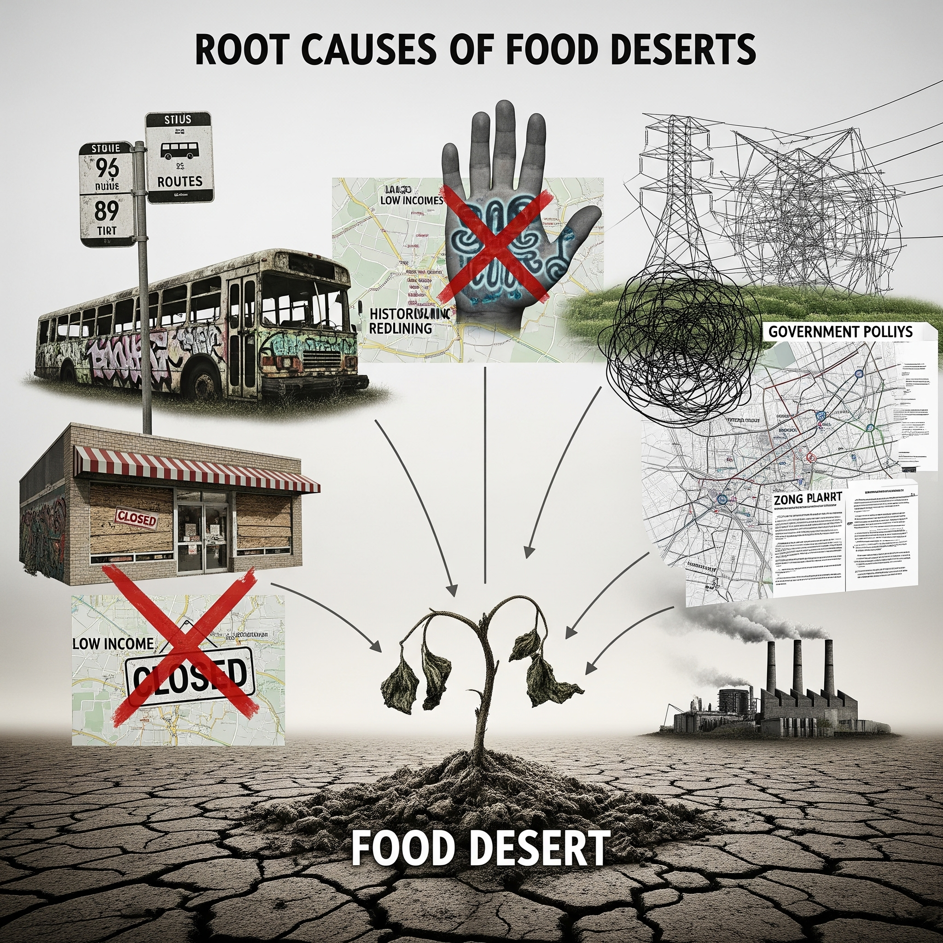
Why It Exists (Root Causes)
Food deserts are caused by structural inequities:
Historic redlining & disinvestment
Commercial redlining → grocery chains avoiding these neighborhoods
Lack of transportation
Low access to financing for local entrepreneurs

Slide 7
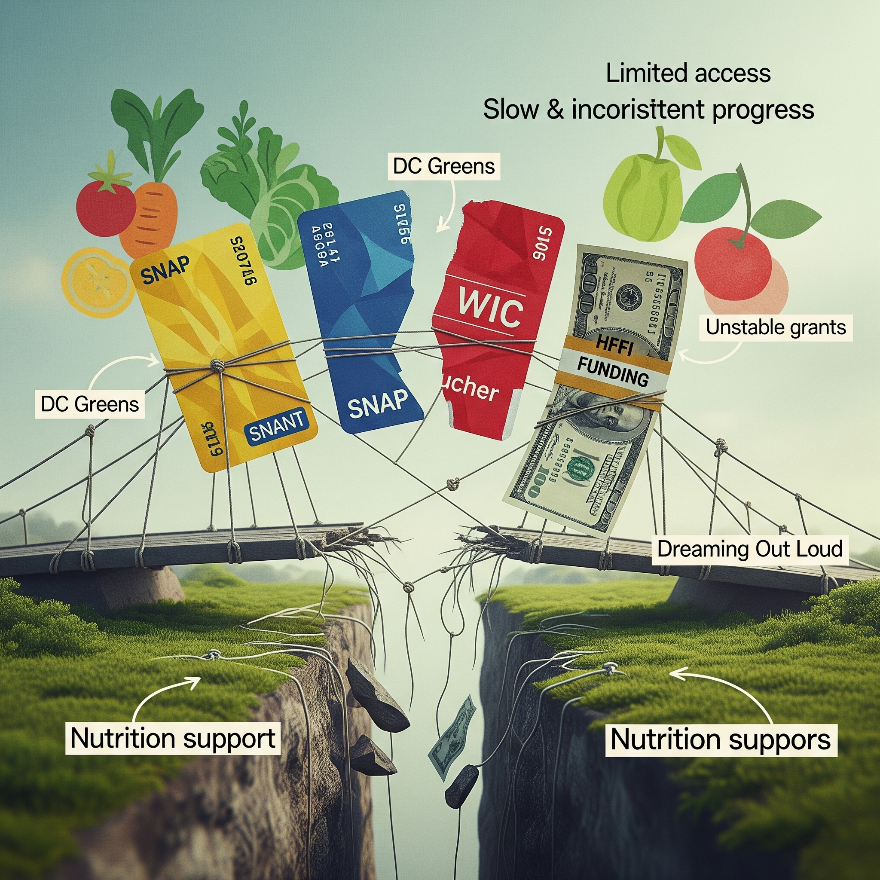
Current Efforts & Why They Fall Short
Programs exist but are limited:
SNAP & WIC = nutrition support but doesn’t create access
HFFI funding helps but progress is slow & inconsistent
Nonprofits (DC Greens, Dreaming Out Loud) help but rely on unstable grants
Efforts lack long-term infrastructure and local ownership

Slide 8
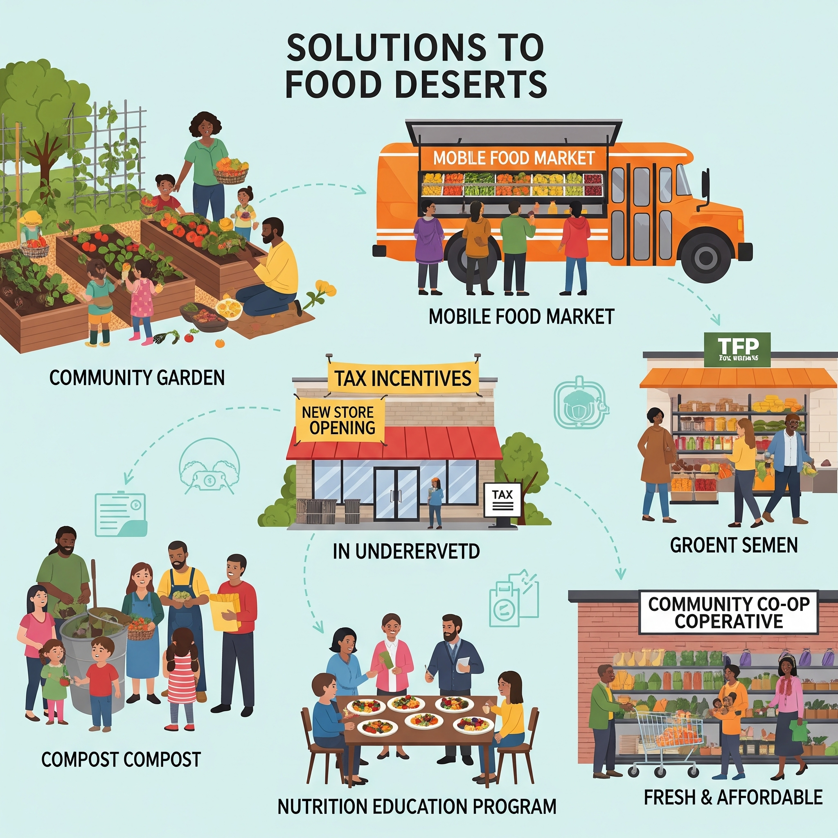
Possible Solutions
Several realistic, evidence-backed solutions include:
Community gardens & urban farming
Mobile food markets
Tax incentives for grocery stores
Nutrition education programs
Community-owned cooperatives

Slide 9
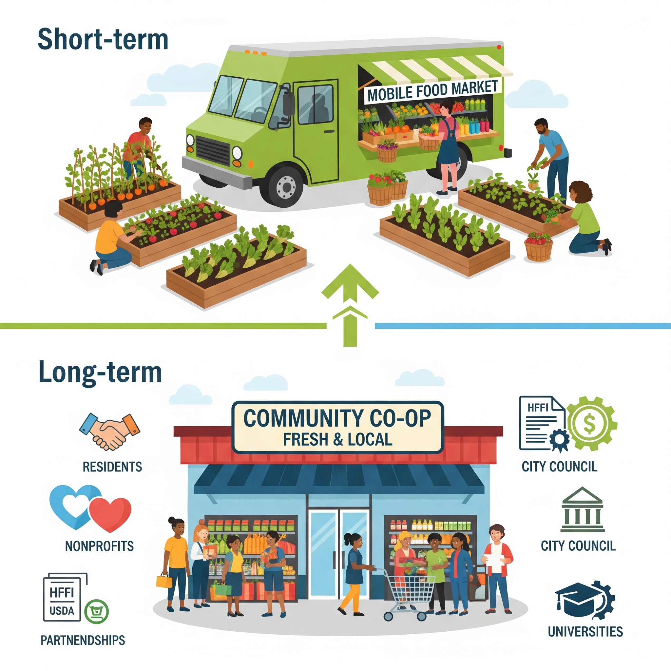
My Proposed Solution
A combined, community-driven approach:
Short-term: Mobile food markets + urban gardens
Long-term:
A community-owned grocery cooperative
Supported by HFFI and USDA grants
Local jobs + economic independence
Partnerships: residents, nonprofits, city council, universities
This empowers communities instead of depending on outside systems.

Slide 10
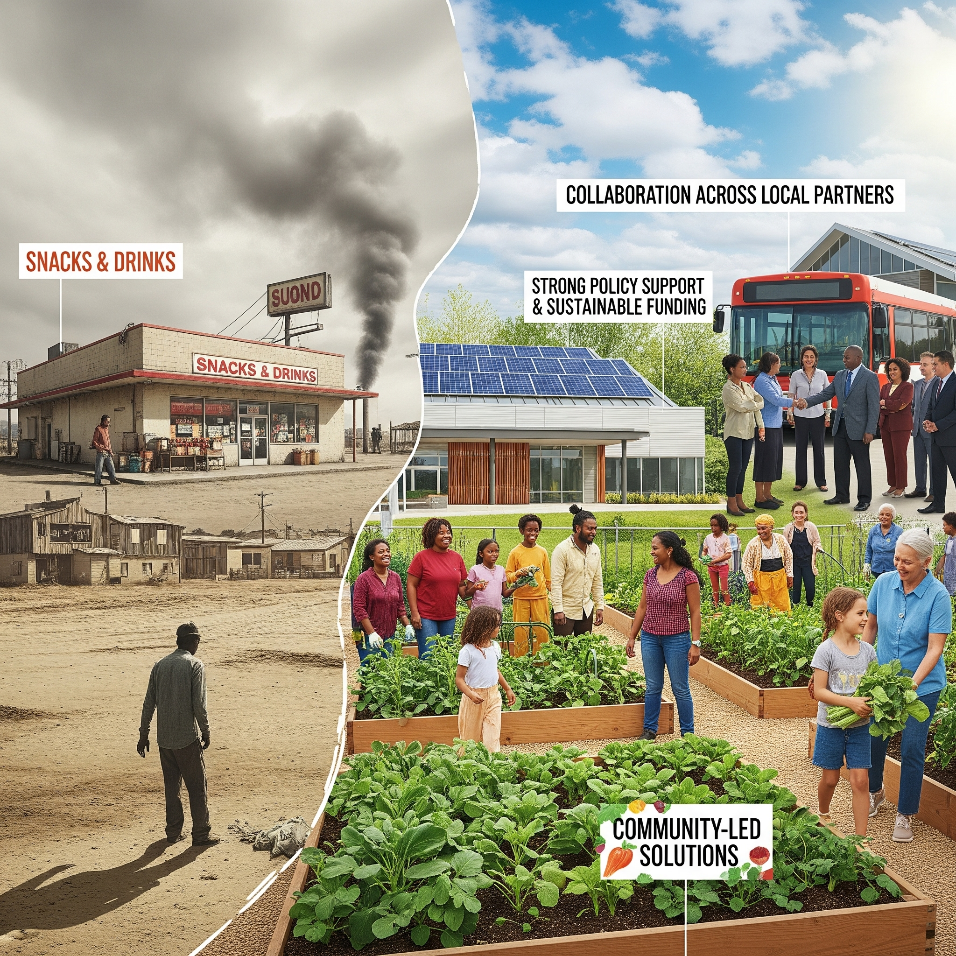
Conclusion
Food deserts are the result of long-term inequities in investment, transportation, and access.
Creating lasting change requires:
Community-led solutions
Strong policy support
Sustainable funding
Collaboration across local partners

